Slide 1
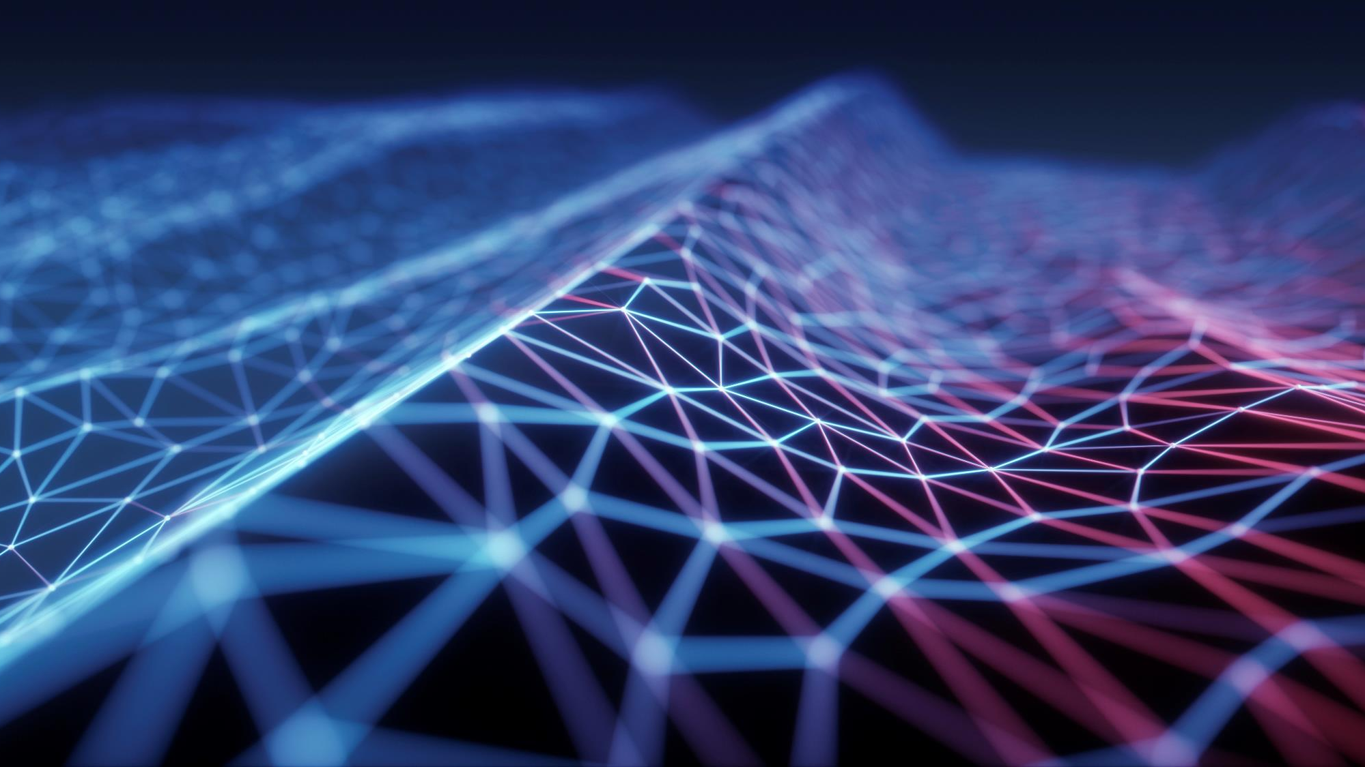
movie recommendation system
Using Machine Learning

Slide 2
Tech Requirements
Google Colab
Python
Stream lit

Slide 3
Introduction
"Unlock personalized cinematic experiences with our Movie Recommender System using cutting-edge Machine Learning and Python. Tailored to individual preferences, our system revolutionizes how you discover and enjoy films, ensuring a curated movie journey just for you."

Slide 4
Problem Statement
User Personalization: Develop a system that understands and adapts to individual user preferences by analyzing their historical movie ratings, genres, and viewing patterns.
Recommendation Accuracy: Implement machine learning algorithms to enhance the accuracy of movie recommendations, ensuring that users receive suggestions aligned with their tastes and preferences.
Scalability and Efficiency: Design a scalable solution capable of handling a large database of movies and users, providing real-time or near-real-time recommendations without compromising system performance.
User Interface Integration: Create an intuitive and user-friendly interface for users to interact with the recommendation system, allowing them to easily provide feedback, explore recommended movies, and adjust preferences.
Exploration of Diverse Content: Ensure that the recommender system introduces users to a diverse range of movies, including those outside their typical preferences, fostering exploration and discovery.
Adaptability to New Content: Develop a system that can adapt to the addition of new movies, ensuring that recommendations remain relevant and up-to-date with the latest releases.

Slide 5
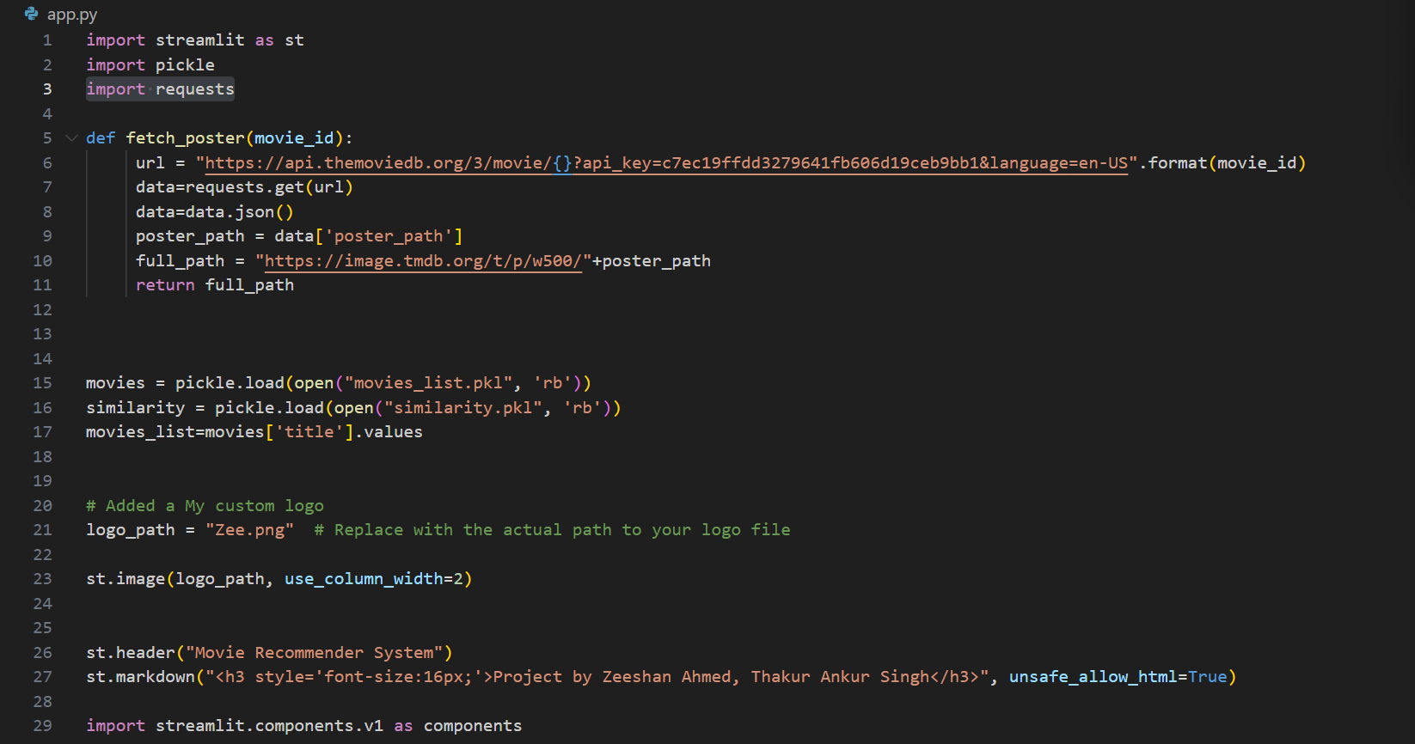
Screenshots of Code

Slide 6
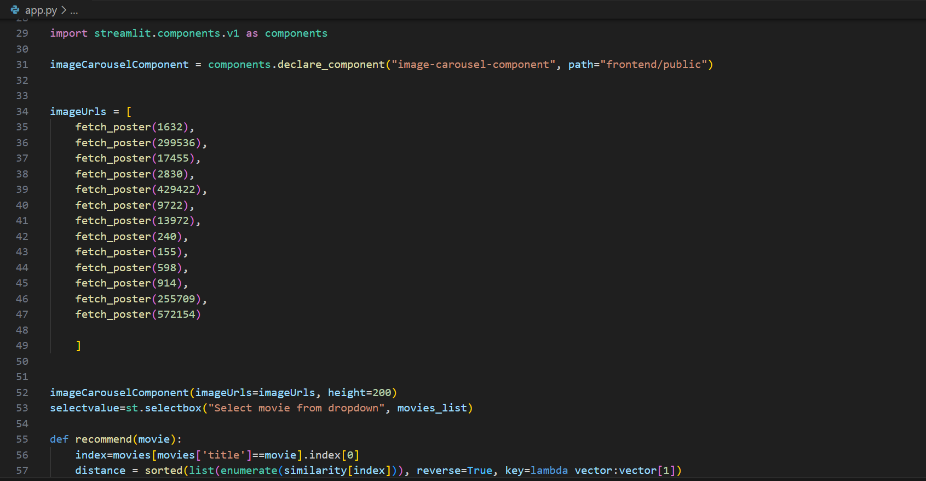

Slide 7
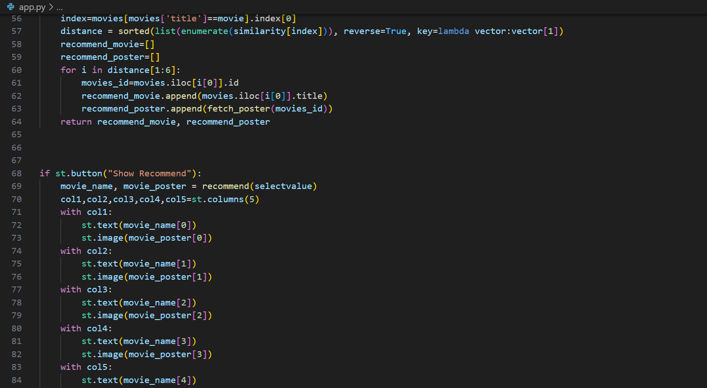

Slide 8
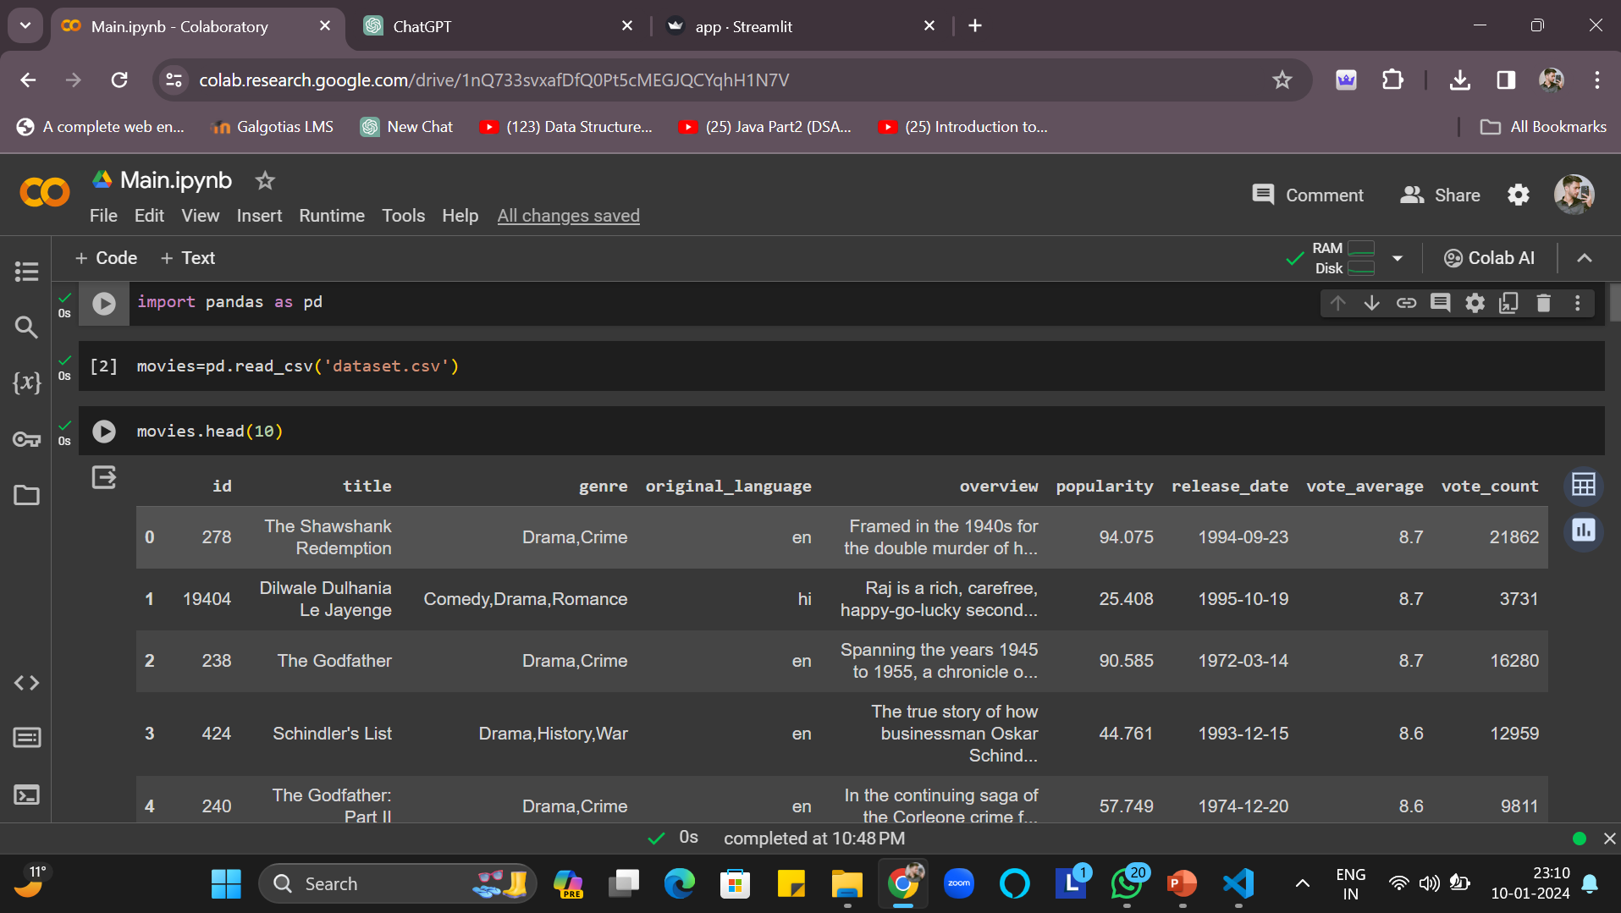
Screenshot of Colab FIle

Slide 9
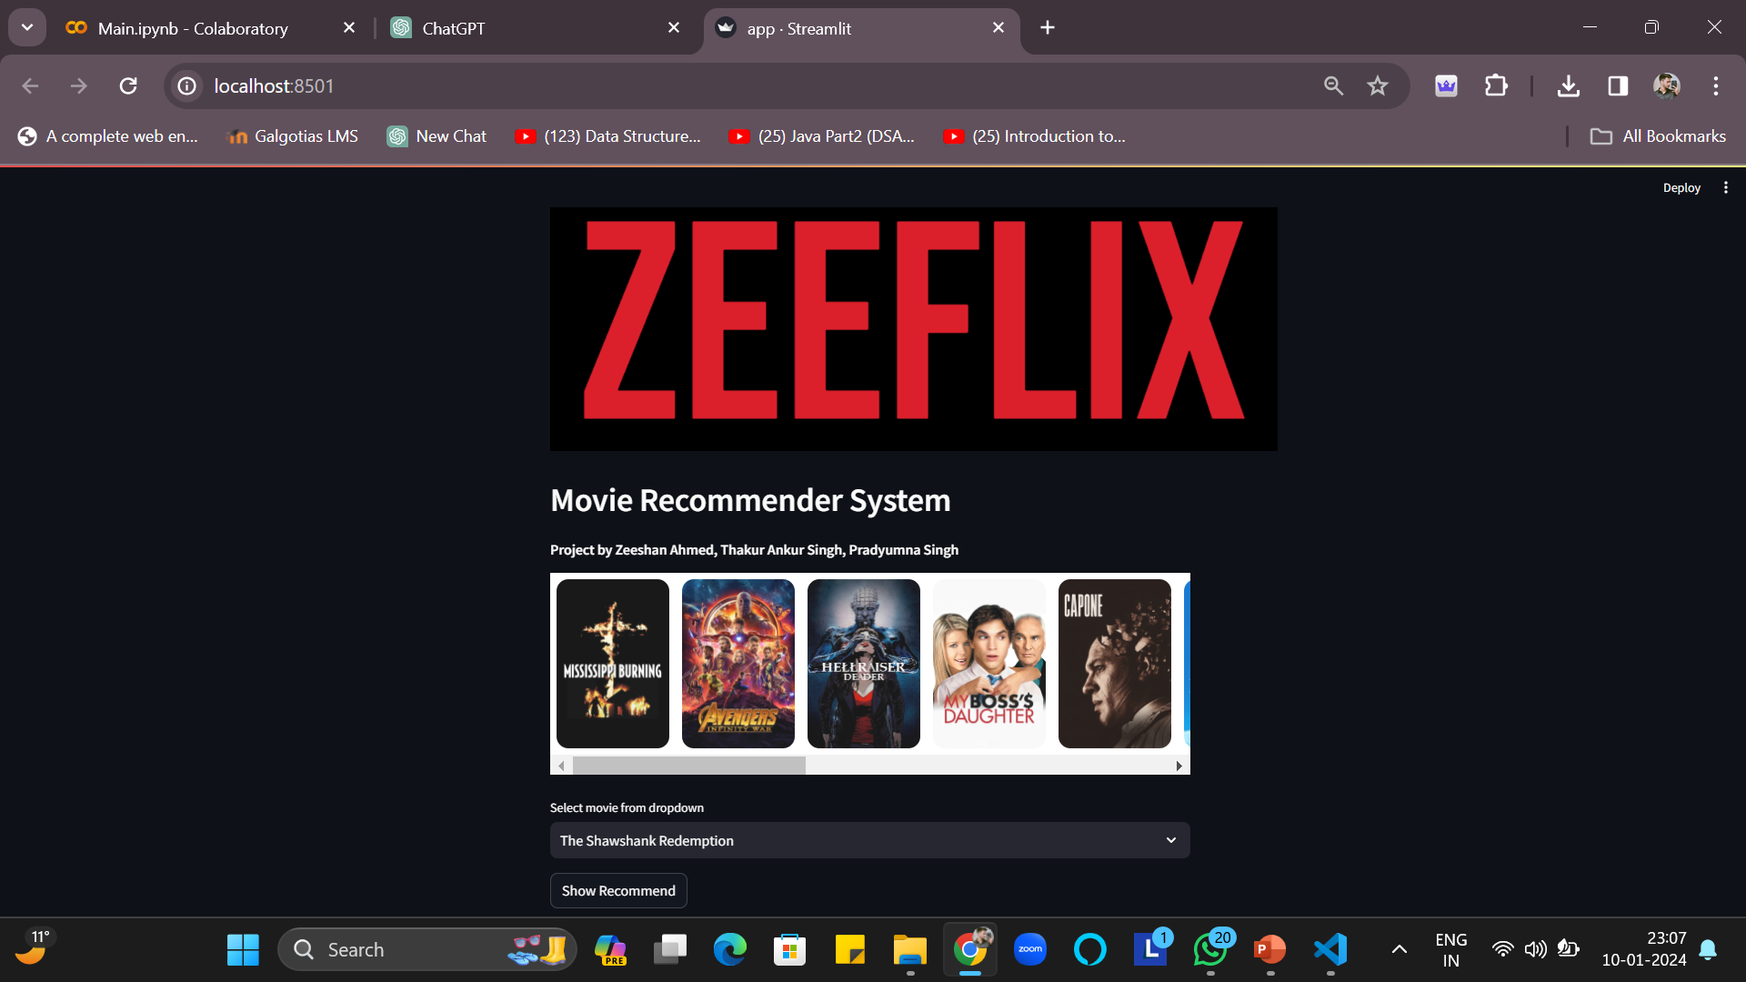
Interface of Project

Slide 10
Conclusion
In conclusion, the development of the Movie Recommender System using ML and Python has proven to be a successful endeavor. Leveraging machine learning algorithms, the system efficiently analyzes user preferences and recommends personalized movie suggestions. The project not only enhances user experience by providing tailored recommendations but also demonstrates the practical application of artificial intelligence in the entertainment industry. As technology continues to evolve, such systems play a pivotal role in shaping the future of content consumption. The robustness and accuracy achieved in this project showcase the potential for further advancements in recommendation systems, contributing to a more engaging and satisfying cinematic experience for users worldwide.

Slide 11

Thank You
Zeeshan Ahmed
Thakur Ankur Singh
Pradyumna Singh

